Slide 1

COVID Lens
Progress Report 2
Isaac Taylor, Mark He, Reagan Berhe, Seth Goodwin, Tammy Ogunkale

Slide 2
COVID Lens Application
System/Algorithm Design and Analysis
Application Wireframe Model
System Architecture
Top-Down Diagram
Use-Case Diagram
Sequence Diagram
Data Flow Diagram
E-R Diagram
Data Dictionary
UML Class Diagrams
Algorithm Analysis
Development Methodology

Slide 3
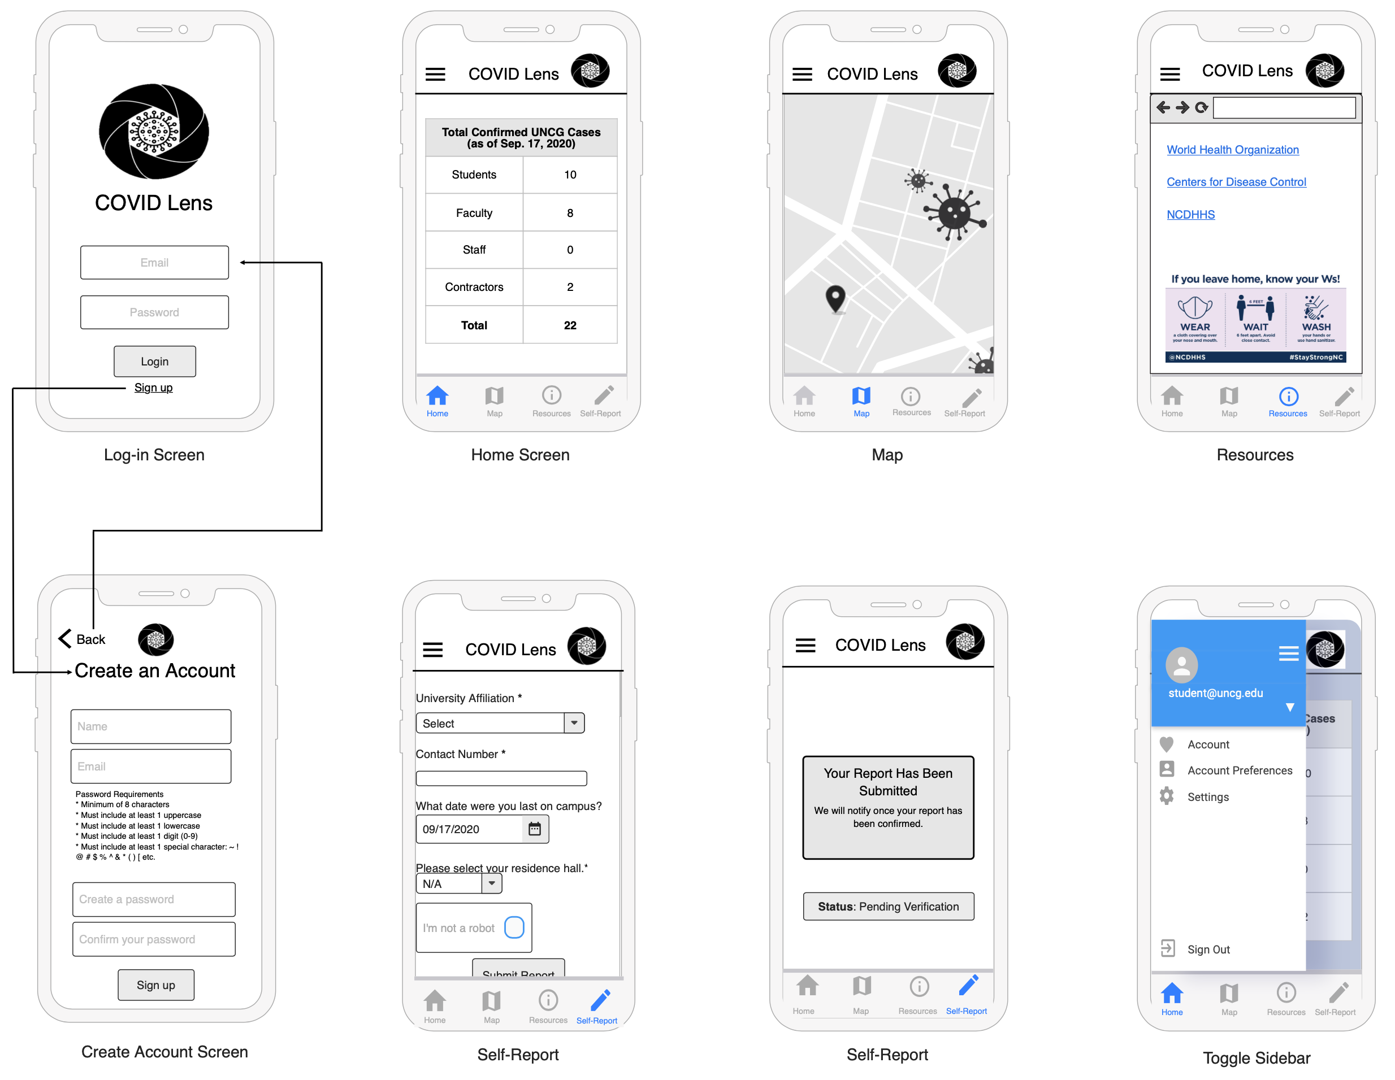
Application Wireframe Model

Slide 4
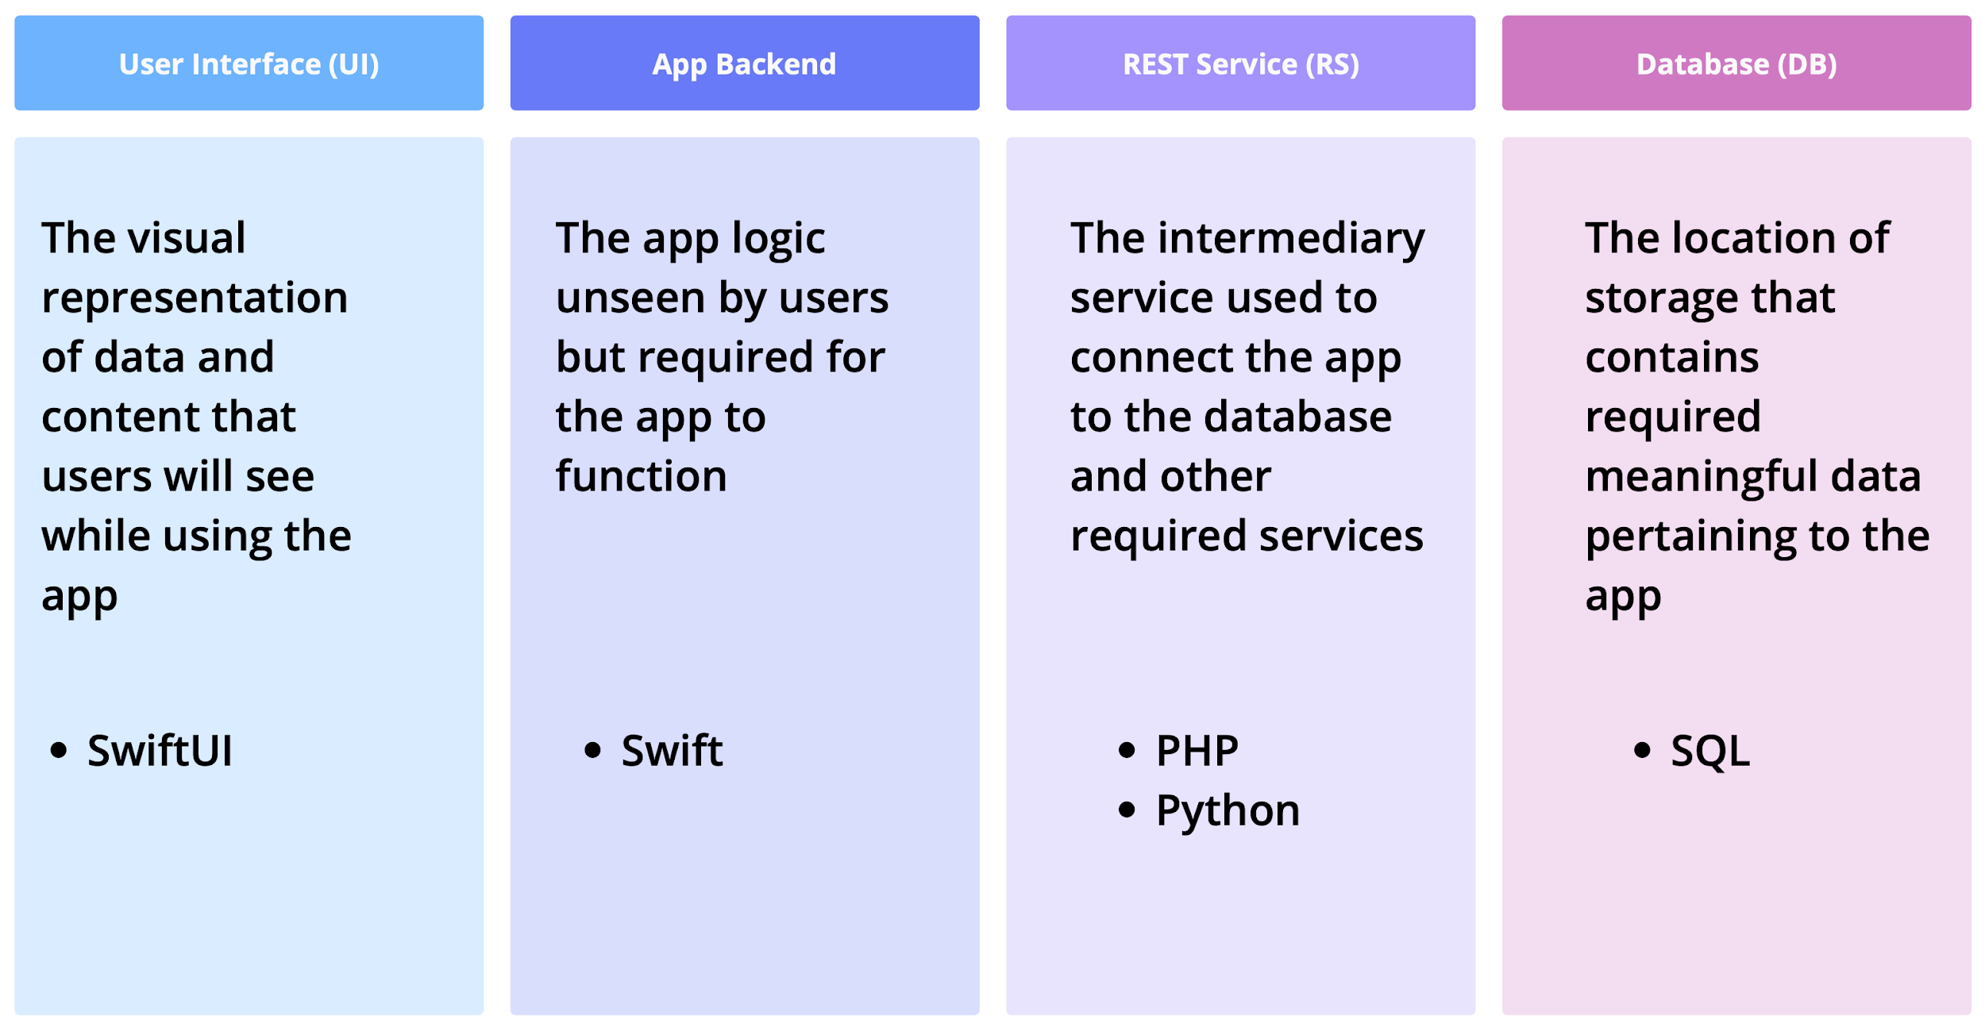
System Architecture

Slide 5
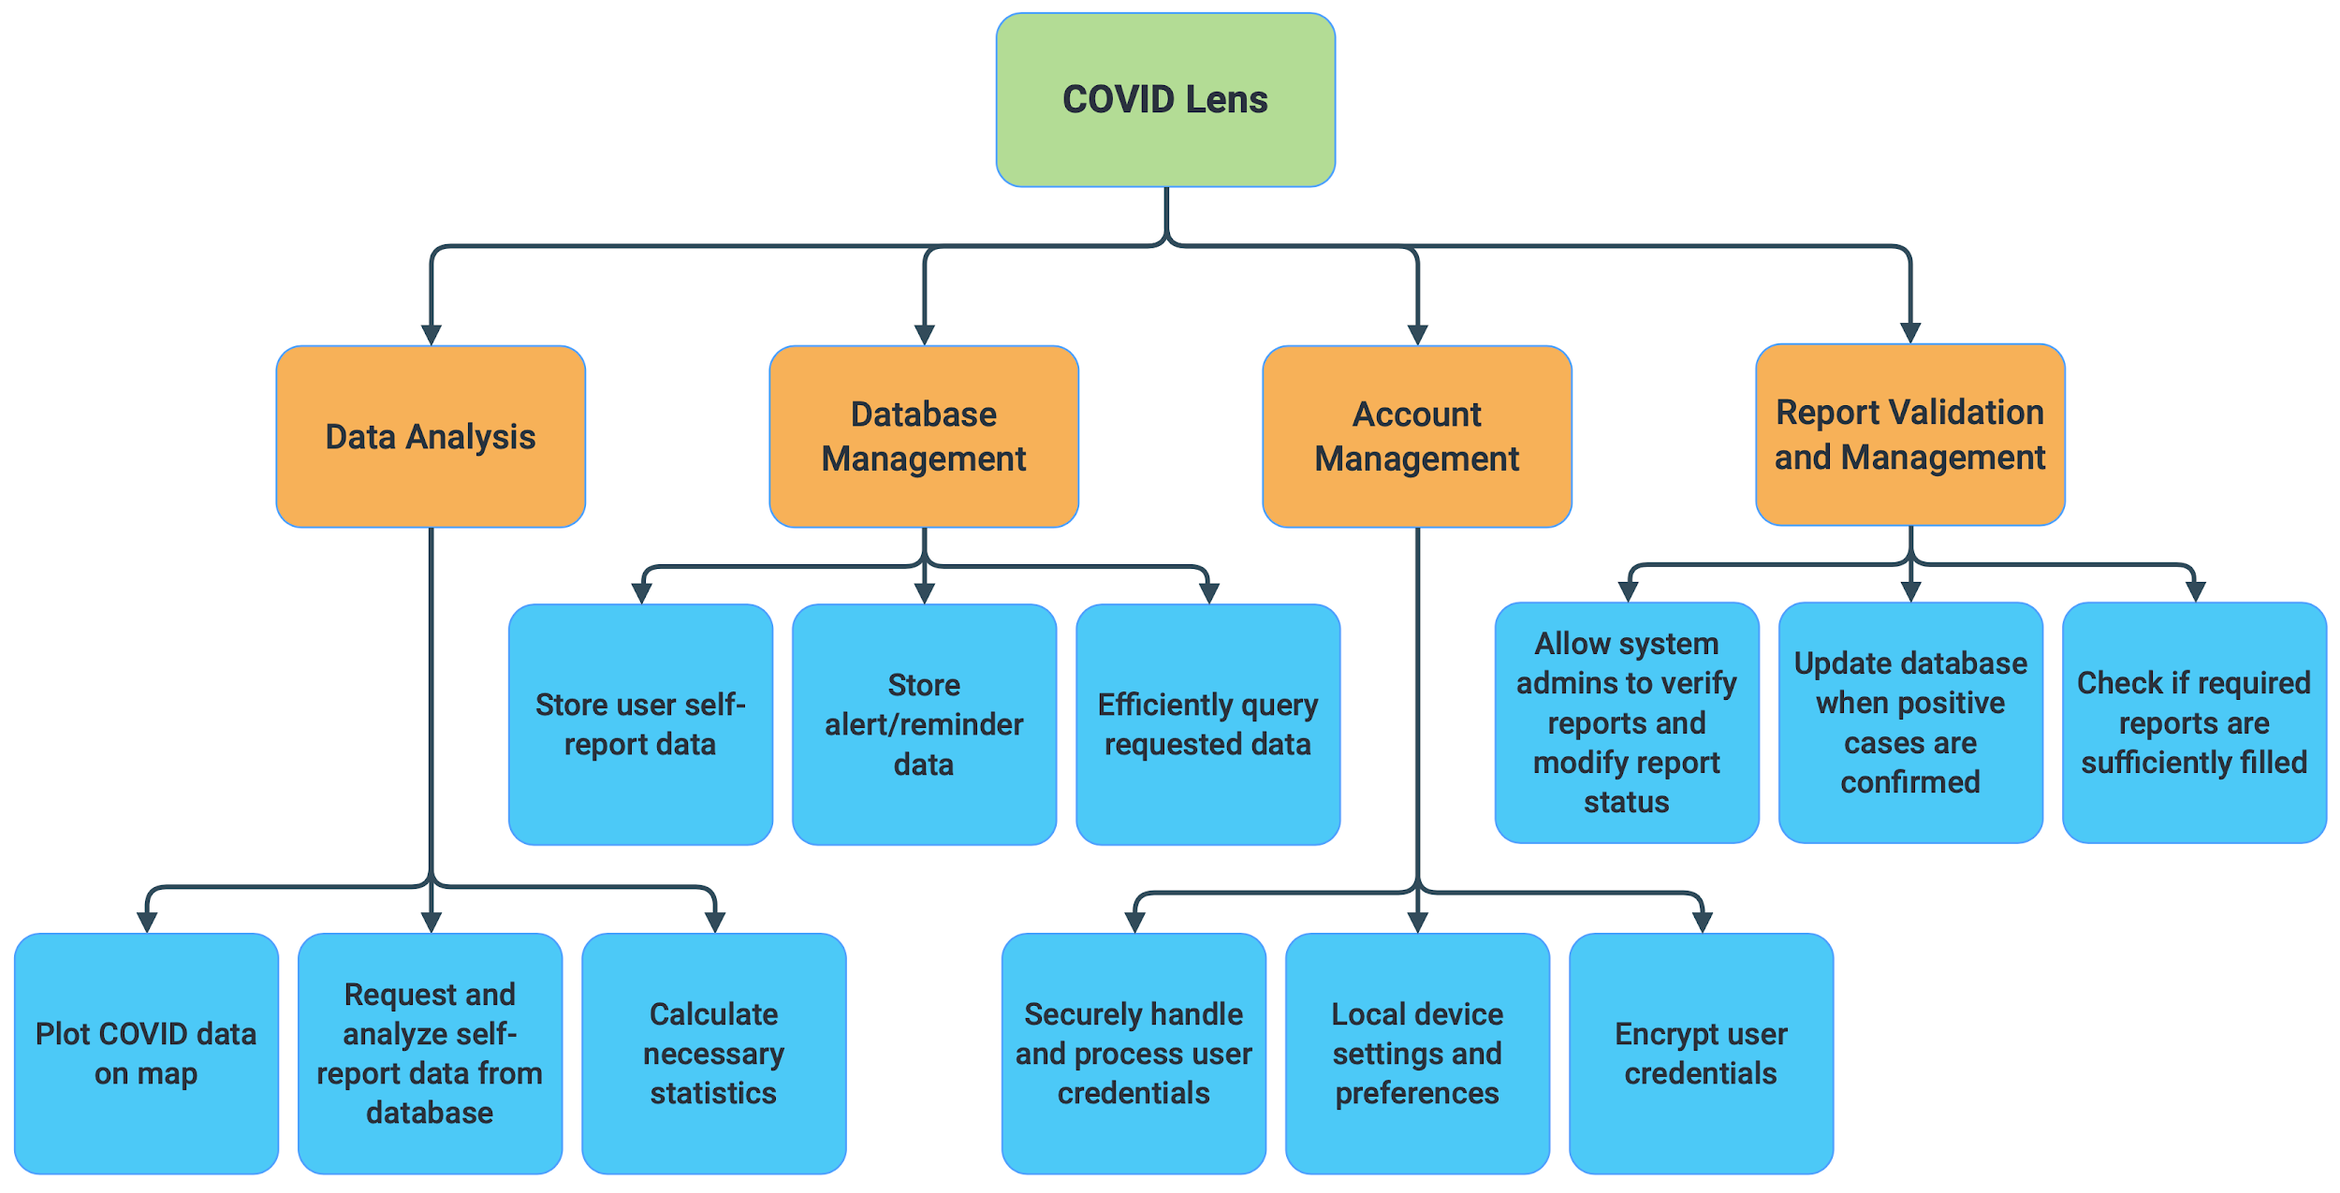
COVID Lens Application
Top-Down Diagram

Slide 6
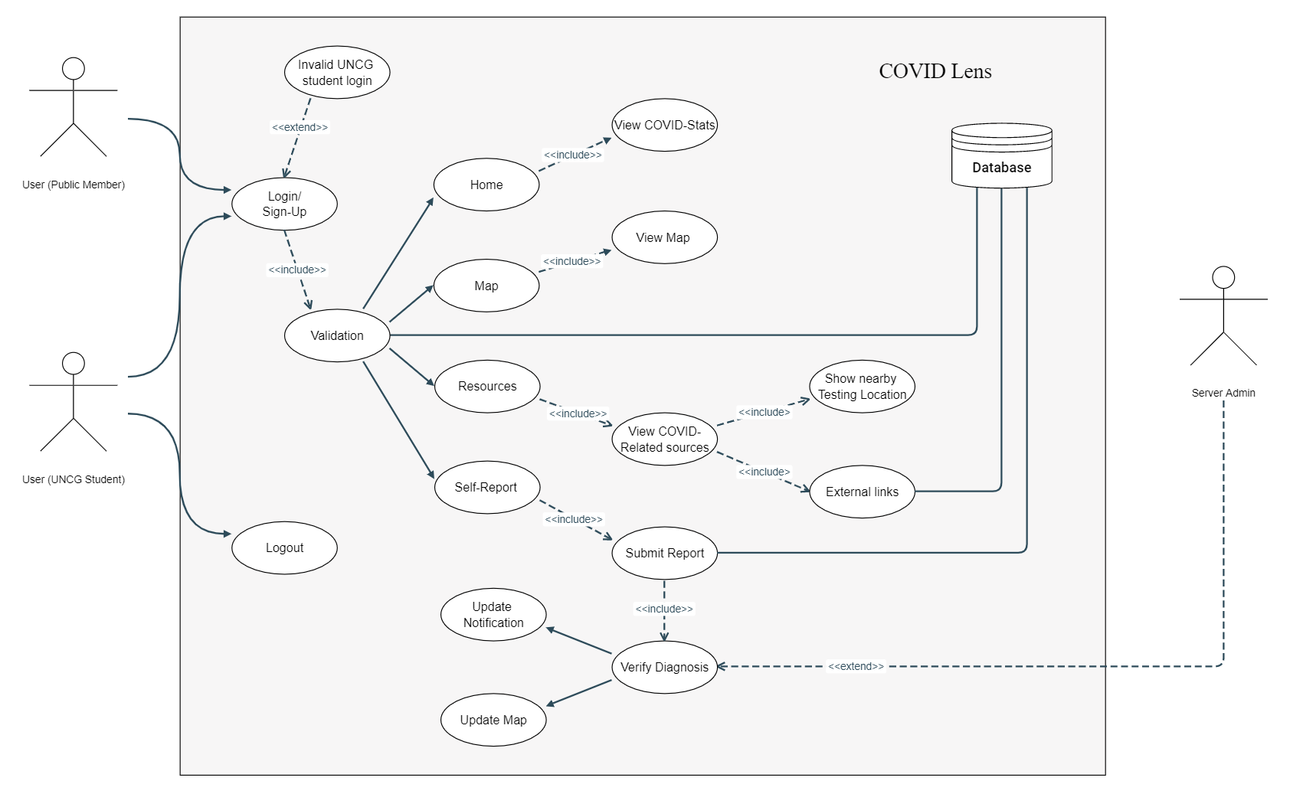
Use-Case Diagram

Slide 7
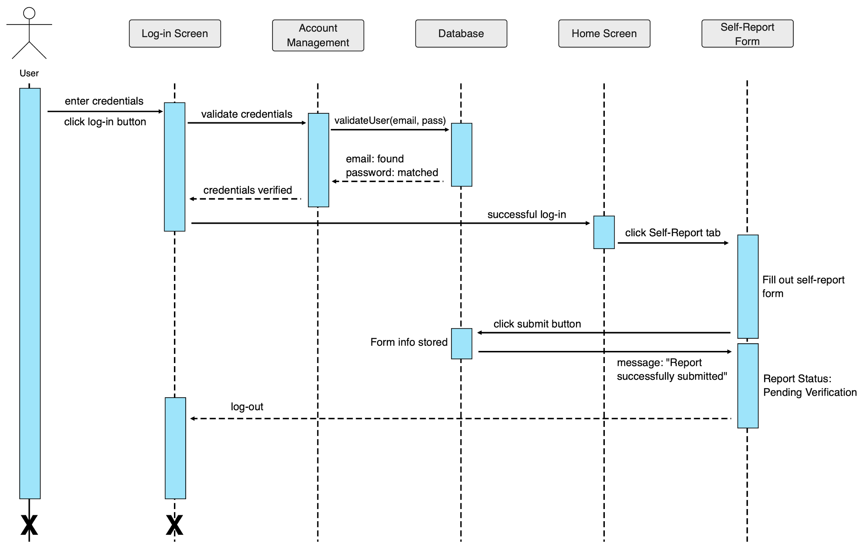
COVID Lens Application
Sequence Diagram
Scenario:
- User logs into the application and submits a self-report form

Slide 8
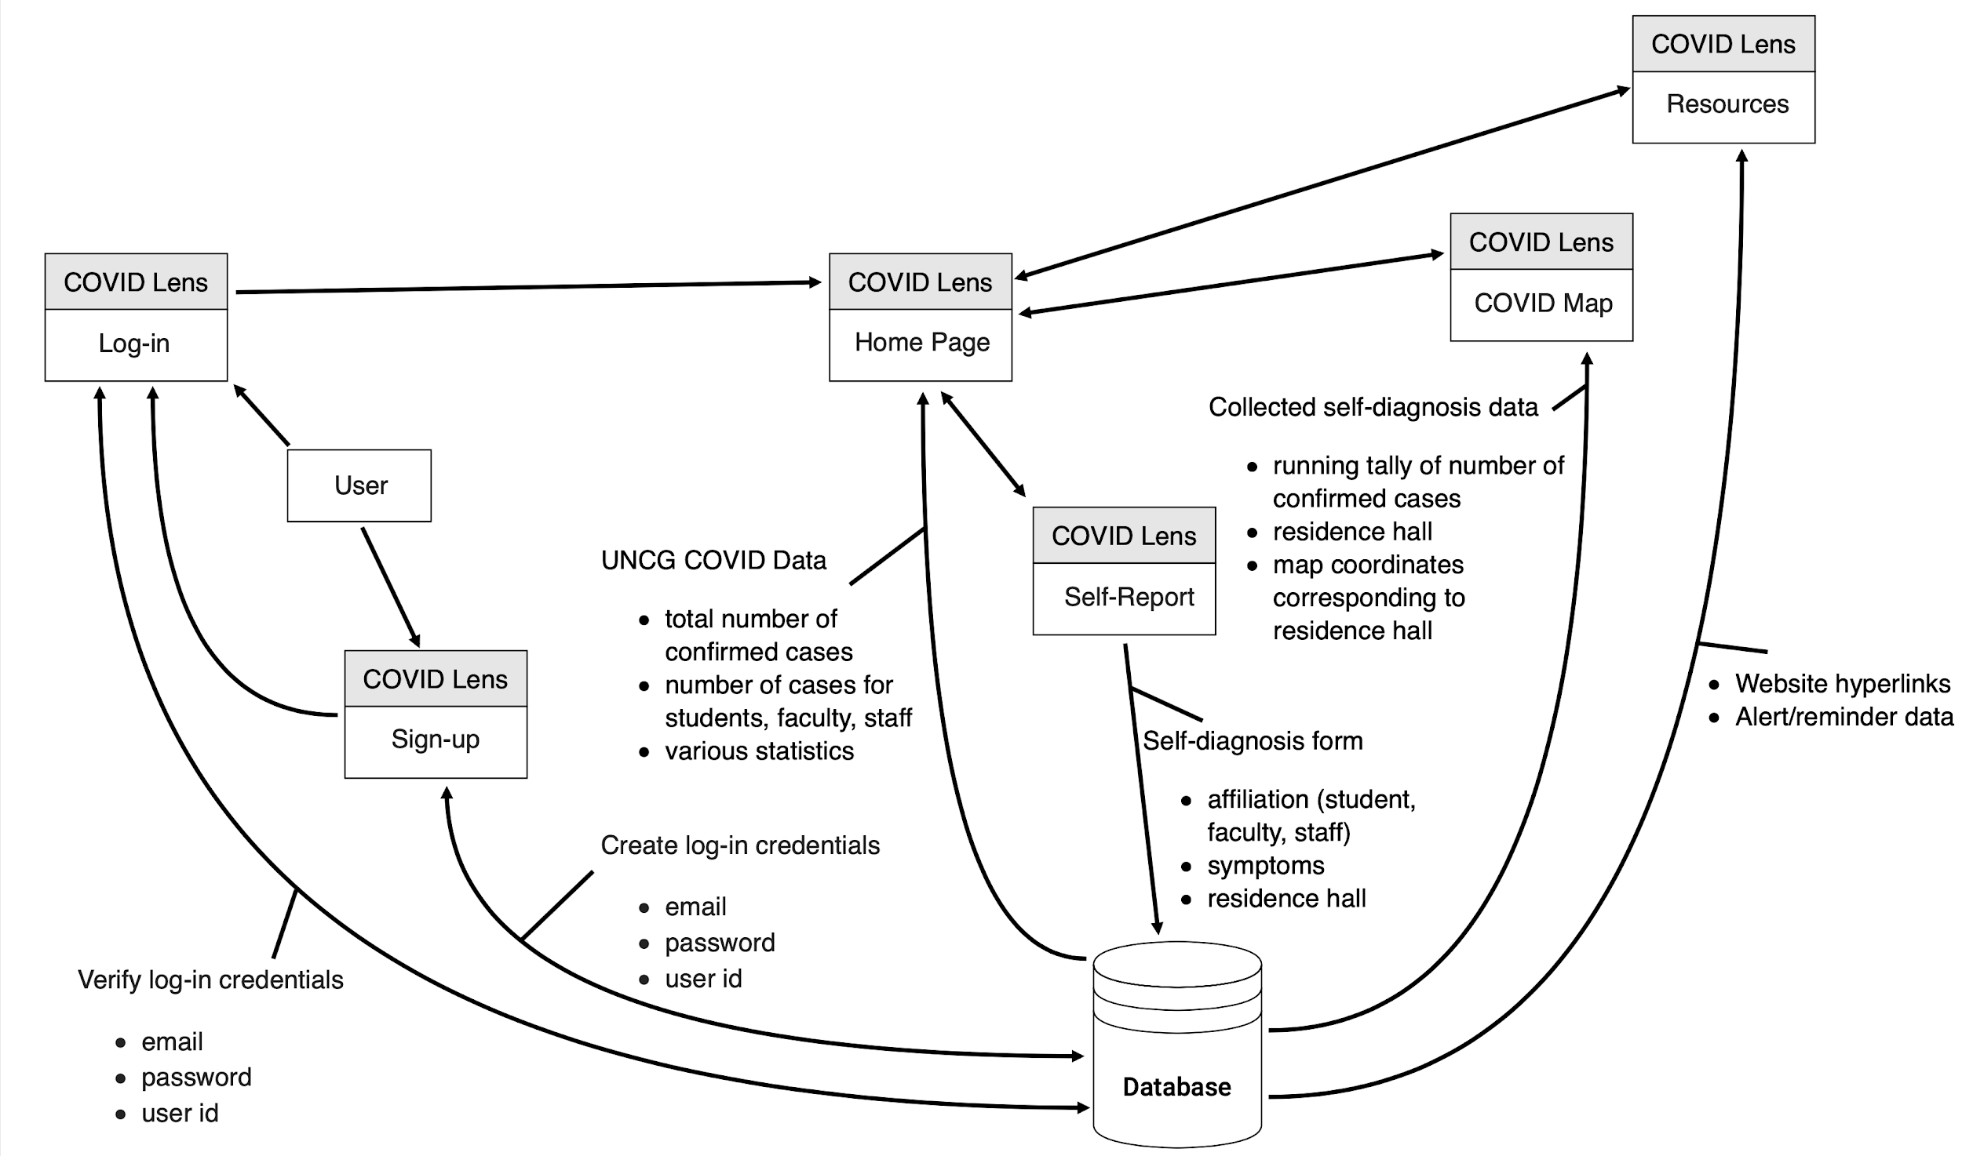
COVID Lens Application
Data Flow Diagram

Slide 9
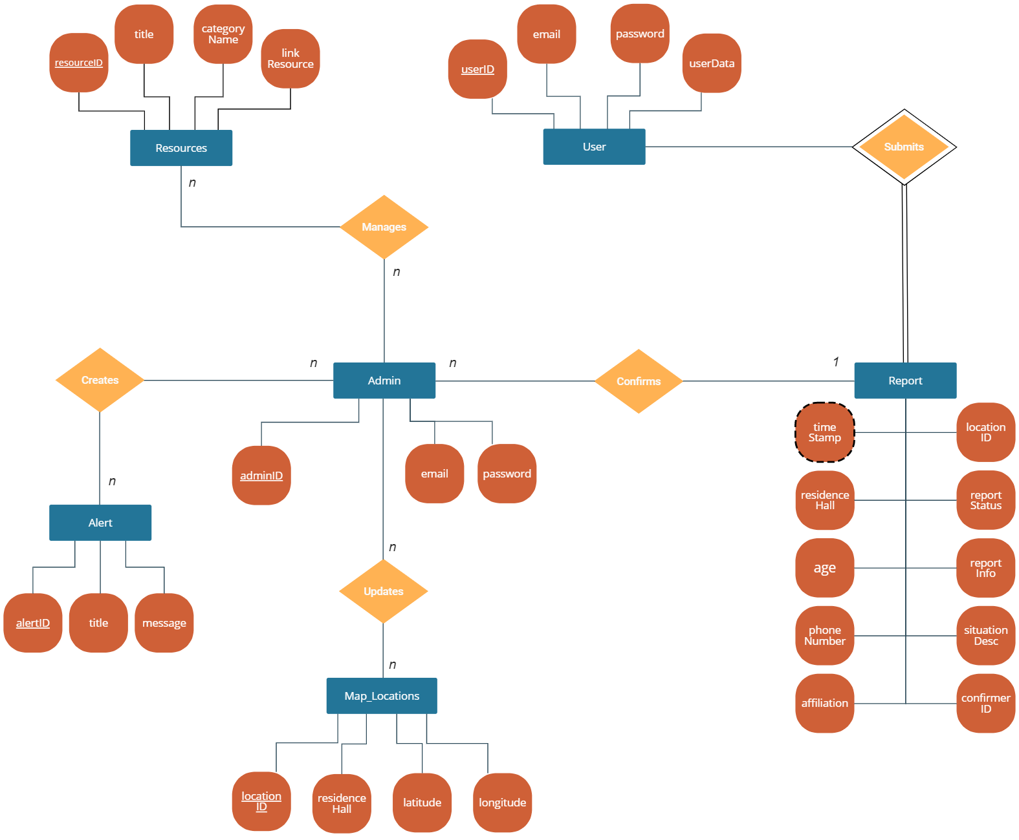
COVID Lens Application
E-R
Model

Slide 10
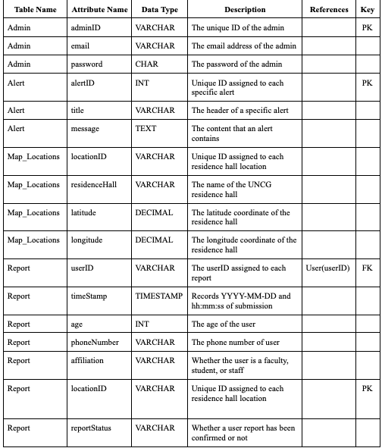
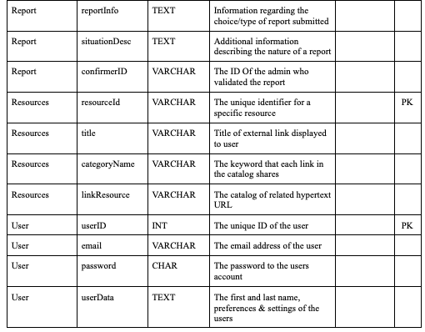
COVID Lens Application
Data Dictionary

Slide 11
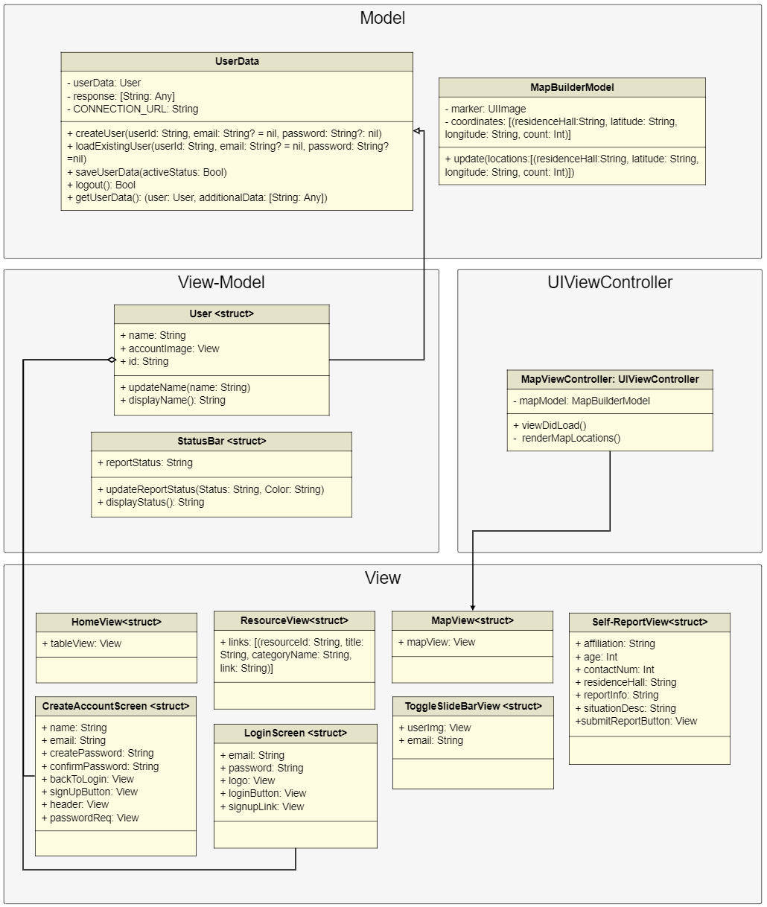
COVID Lens Application
UML Class Model -
Swift (MVVM)
Arrows on this diagram are not exactly representative of inheritance but rather connectivity.

Slide 12
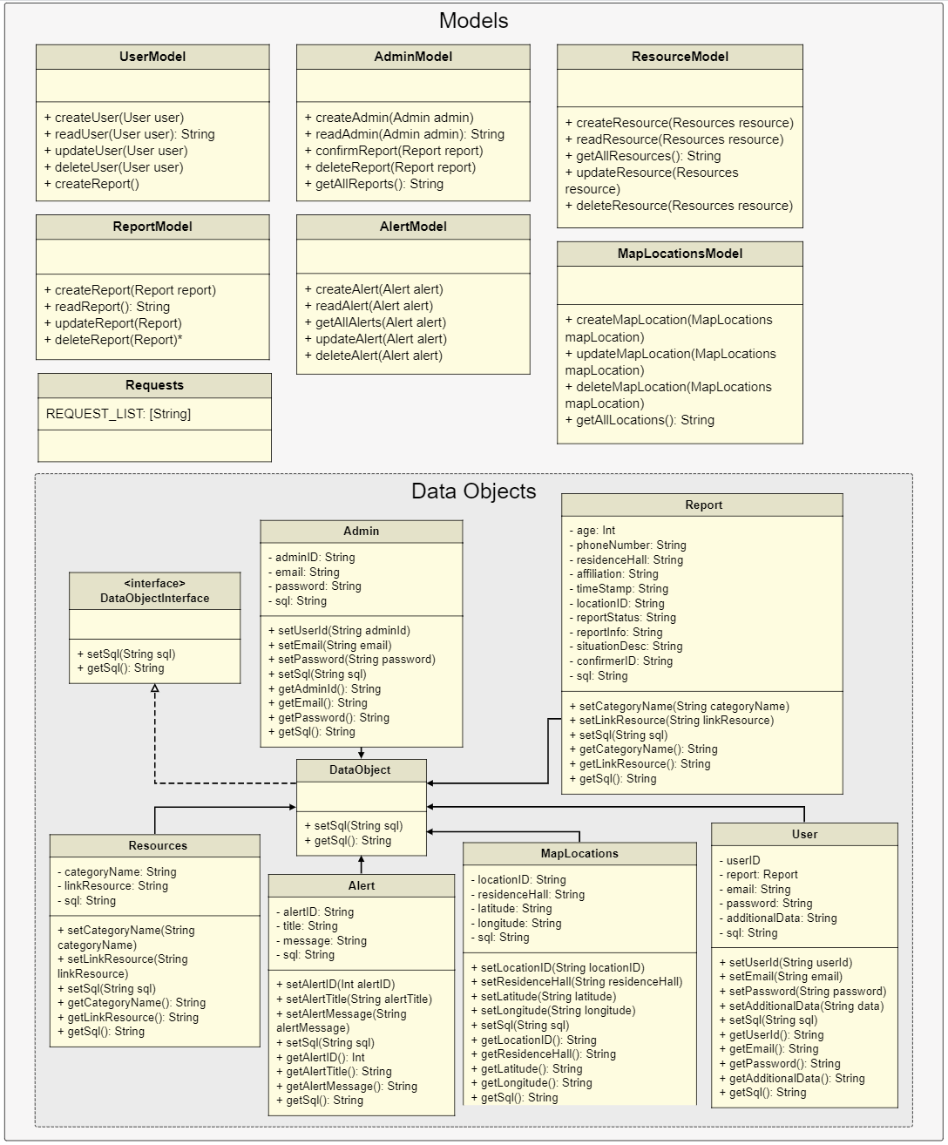
COVID Lens Application
UML Class Model -
PHP (MVC)

Slide 13
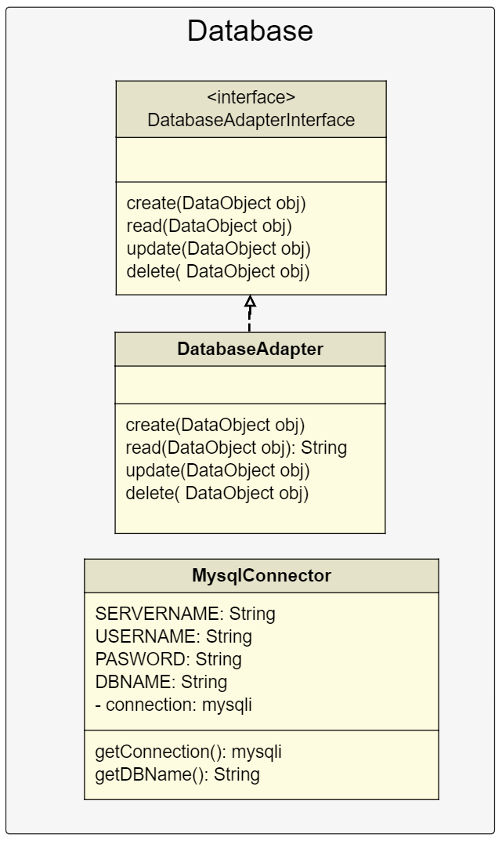
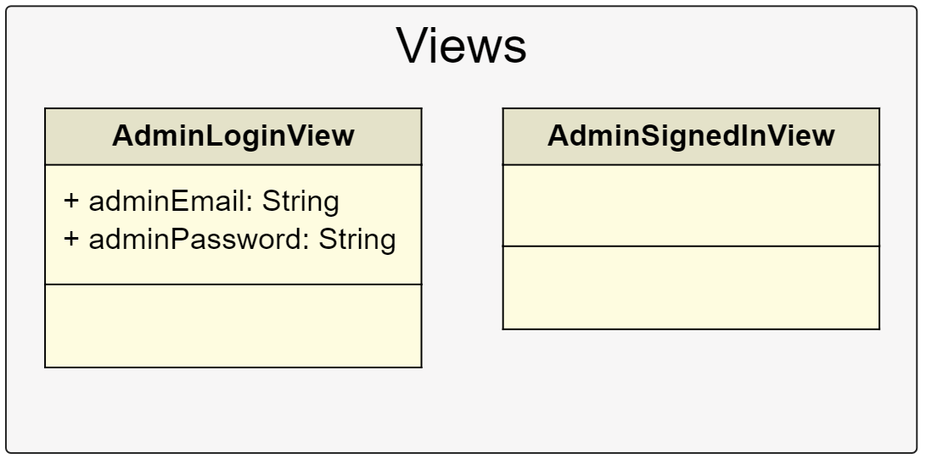
COVID Lens Application
UML Class Model -
PHP (MVC) Continued

Slide 14
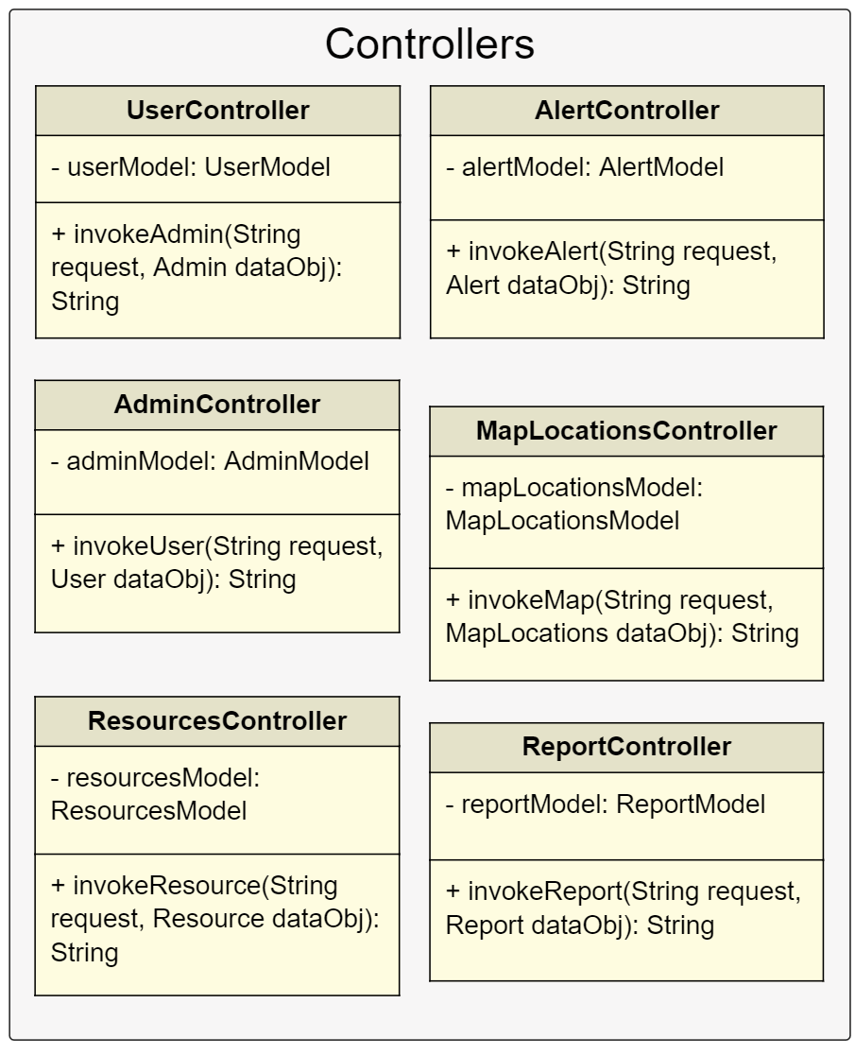
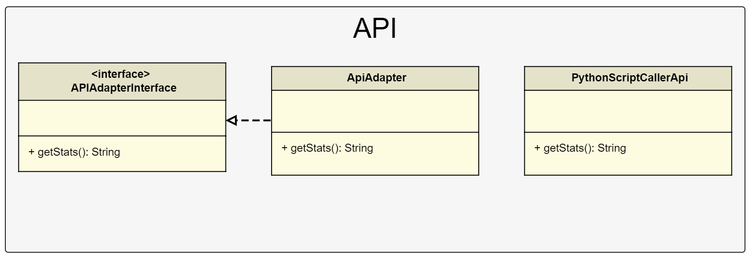
COVID Lens Application
UML Class Model -
PHP (MVC) Continued

Slide 15
COVID Lens Application
Algorithm Analysis
Overall system is expected to have a time complexity of O(n log n).
Time complexity breakdown by subsystems:
Database Management -
simple querying, is generally O(n).
access an index - O(1).
Data Analysis -
calculation of simple statistics is expected to take linear time (sorting brings the expected time complexity to O(n log n).
Account Management -
creating, deleting, updating, and accessing an account is expected to take O(1) time.
searching for an account would require O(n) time, however.
Report Validation and Management -
creating, deleting, and updating a user’s report would take O(1) time.
displaying all user reports is expected to be O(n) time.

Slide 16
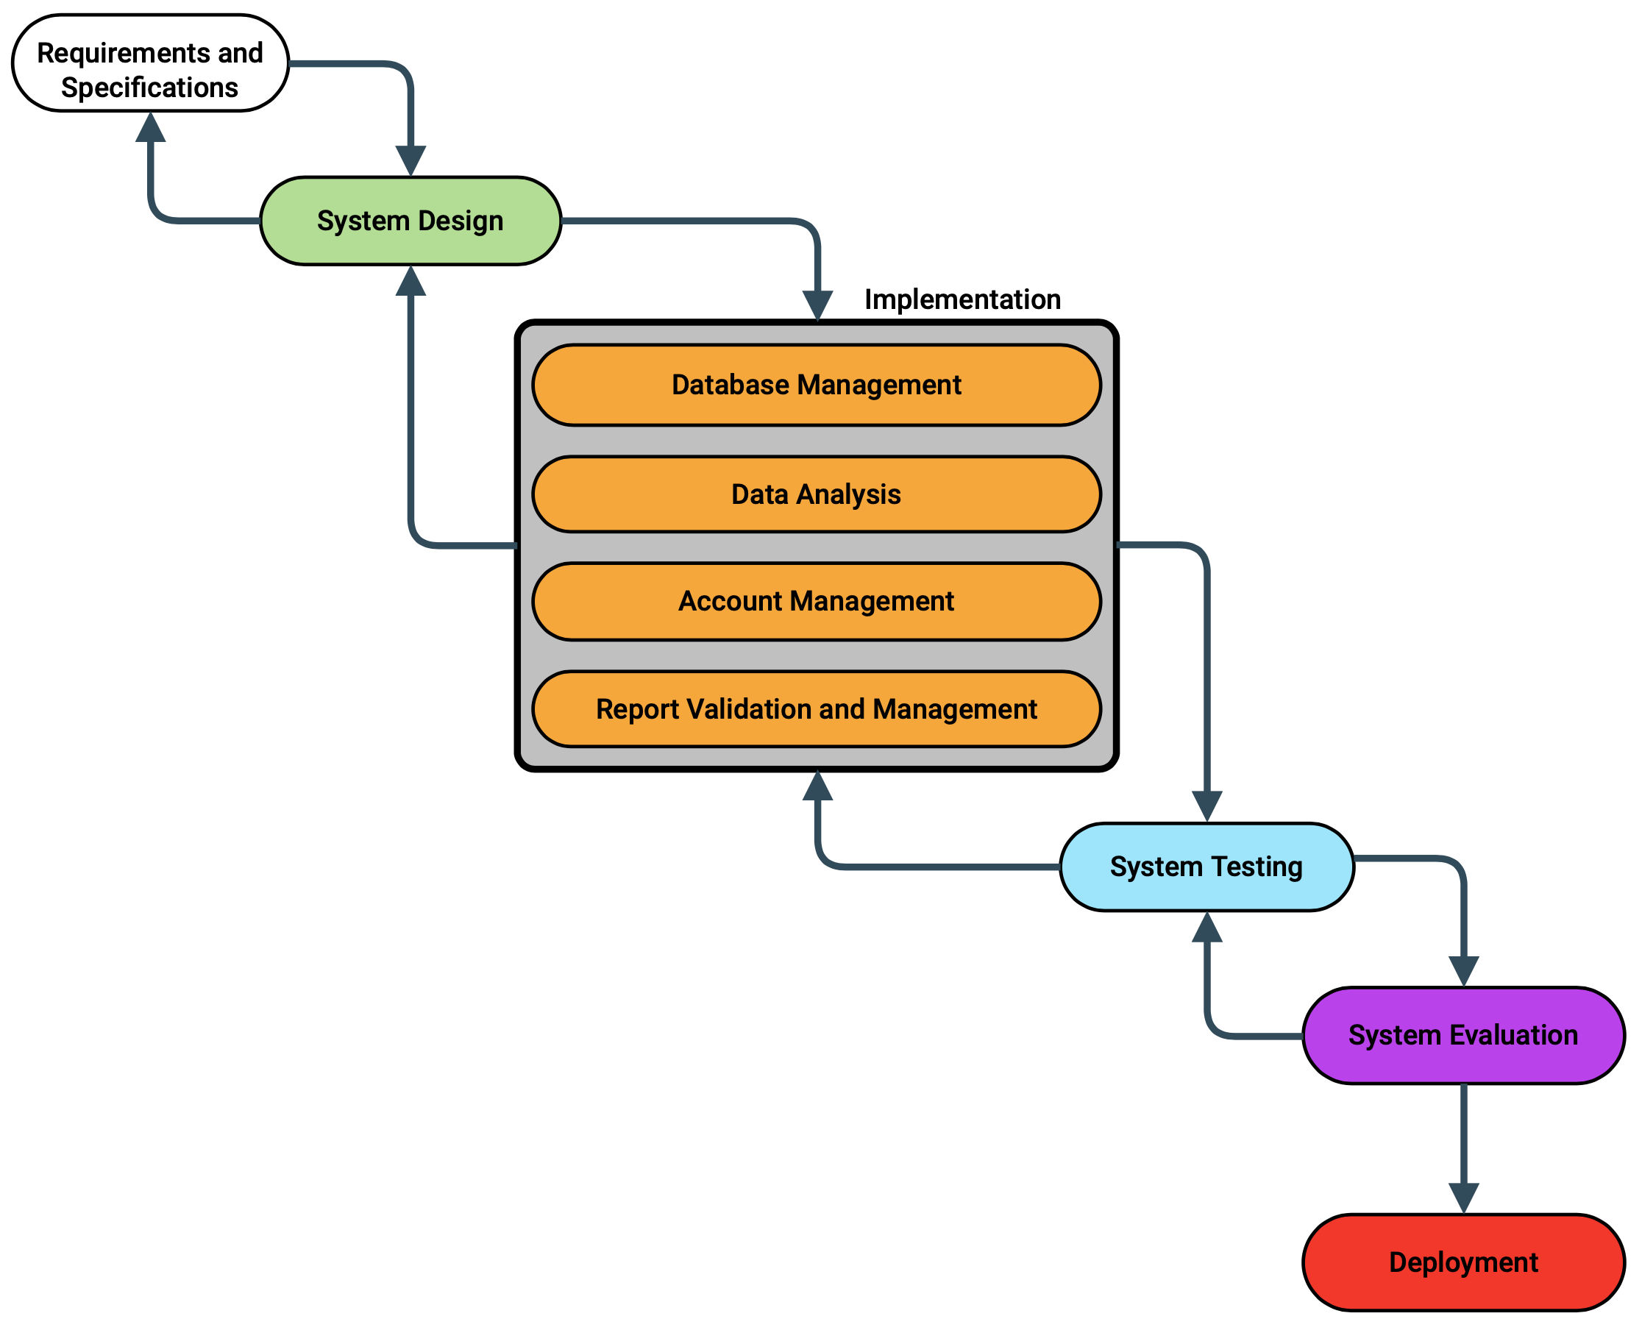
Development
Methodology
Moving Forward...

